Slide 1
Personality, motivation and emotion unit-5

Slide 2
Personality
The term personality is derived from the Latin word persona which means mask.
Personality -It refers to individual differences in characteristic patterns of thinking, feeling and behaving.
Personality is the combination of behavior, emotion, motivation, and thought patterns that define an individual.

Slide 3
Psychoanalysis
Psychoanalysis is a theory of personality and a method of psychotherapy developed by Sigmund Freud.
It explains human behaviour in terms of unconscious motives, childhood experiences, inner conflicts, and repressed desires.

Slide 4
Psychoanalysis
1. Structure of Personality
Id – pleasure-seeking, instinctual part
Ego – realistic, decision-making part
Superego – moral and ideal standards
These three constantly interact and create internal conflicts.
2. Levels of Mind
Conscious – what we are aware of
Preconscious – stored memories
Unconscious – hidden desires, fears, and repressed thoughts (most important)
Psychosexual Stages
Personality develops through five stages:
Oral → Anal → Phallic → Latency → Genital
Fixation at any stage can affect adult behaviour.

Slide 5
Psychosexual stages
Stage | Age Range | Erogenous Zone | Key Conflict / Focus | Adult Fixation / Outcomes
Oral | 0 – 1.5 years | Mouth (sucking, biting) | Weaning | Smoking, overeating, nail-biting, dependency
Anal | 1.5 – 3 years | Bowel & bladder control | Toilet training | Anal-retentive (perfectionist, orderly) OR Anal-expulsive (messy, careless)
Phallic | 3 – 6 years | Genitals | Oedipus/Electra complex | Vanity, recklessness, problems with authority, sexual confusion
Latency | 6 – 12 years | Dormant sexual energy | Social & academic development | No major fixation; focus on social and cognitive growth
Genital | 12+ years | Genitals (mature sexuality) | Establishing intimate relationships | Well-balanced personality OR unresolved earlier conflicts reappear

Slide 6
Psychosocial development
Erikson proposed eight stages of human development, from infancy to old age.
Each stage presents a psychosocial crisis that must be resolved for healthy personality development.
Successful resolution leads to virtues, while failure leads to difficulties in later stages.

Slide 7
Psychosocial development
Stage | Age Range | Crisis (Conflict) | Positive Outcome (Virtue) | Negative Outcome
1. Trust vs. Mistrust | 0 – 1 year | Developing trust in caregivers | Hope | Fear, insecurity
2. Autonomy vs. Shame & Doubt | 1 – 3 years | Independence in walking, choosing | Willpower | Shame, doubt, dependence
3. Initiative vs. Guilt | 3 – 6 years | Taking initiative in play, activities | Purpose | Guilt, overcontrol
4. Industry vs. Inferiority | 6 – 12 years | Learning skills, school activities | Competence | Inferiority, failure feelings
5. Identity vs. Role Confusion | 12 – 18 years | Developing personal identity | Fidelity | Confusion about self
6. Intimacy vs. Isolation | 18 – 40 years | Forming close relationships | Love | Loneliness, isolation
7. Generativity vs. Stagnation | 40 – 65 years | Contributing to society, work, family | Care | Stagnation, unproductiveness
8. Integrity vs. Despair | 65+ years | Reflecting on life | Wisdom | Regret, dissatisfaction

Slide 8
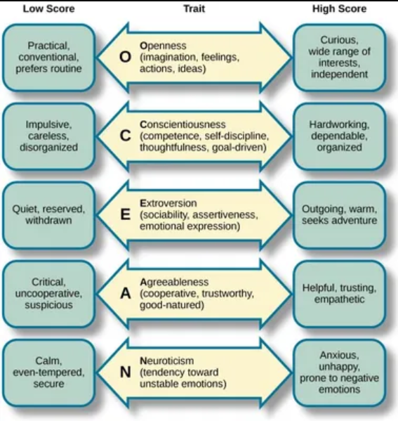
Big 5 Personality Theory

Slide 9
Jung’s Personality Theory of Extraverts/ Introverts
Introvert and extravert, basic personality types according to the theories of the 20th-century Swiss psychiatrist Carl Jung. According to these theories, an introvert is a person whose interest is generally directed inward toward his own feelings and thoughts, in contrast to an extravert, whose attention is directed toward other people and the outside world. The typical introvert is shy, contemplative, and reserved and tends to have difficulty adjusting to social situations. Excessive daydreaming and introspection, careful balancing of considerations before reaching decisions, and withdrawal under stress are also typical of the introverted personality. The extravert, by contrast, is characterized by outgoingness, responsiveness to other persons, activity, aggressiveness, and the ability to make quick decisions.

Slide 10
Type A / Type B Theory of Personality by Meyer Friedman and Ray Rosenman
This type of personality concerns how people respond to stress.

Slide 11
Type A / Type B Theory of Personality by Meyer Friedman and Ray Rosenman
Type A Personality
Type A personality is characterized by a constant feeling of working against the clock and a strong sense of competitiveness. Individuals with a Type A personality generally experience a higher stress level, hate failure and find it difficult to stop working, even when they have achieved their goals. Type A individuals tend to be very competitive and self-critical. They strive toward goals without feeling a sense of joy in their efforts or accomplishments. Interrelated with this is the presence of a significant life imbalance. This is characterized by a high work involvement. Type A individuals are easily ‘wound up’ and tend to overreact. They also tend to have high blood pressure (hypertension). Type A individuals tend to be easily aroused to anger or hostility, which they may or may not express overtly. Such individuals tend to see the worse in others, displaying anger, envy and a lack of compassion.

Slide 12
Type A / Type B Theory of Personality by Meyer Friedman and Ray Rosenman
Type B Personality
Type B personality is characterized by a relaxed, patient, and easy-going nature. Individuals with a Type B personality work steadily, enjoying achievements, but do not tend to become stress when goals are not achieved. People with Type B personality tend to be more tolerant of others, are more relaxed than Type A individuals, more reflective, experience lower levels of anxiety and display a higher level of imagination and creativity.

Slide 13
Bandura’s Social Learning Theory of Personality
Bandura’s Social Learning Theory of Personality is based on the premise that human behaviour is largely acquired and that the principles of learning are sufficient to account for the development and maintenance of behaviour. But the earlier learning theorists were unable to pay sufficient attention about the social context in which behaviour is taking place. Bandura has done a great deal of work on social learning throughout his career and is famous for his “Social Learning Theory” which he has recently renamed, “Social Cognitive Theory”.
Bandura is seen by many as a cognitive psychologist because of his focus on motivational factors and self-regulatory mechanisms that contribute to a person’s behaviour, rather than just environmental factors. This focus on cognition is what differentiates social cognitive theory from Skinner’s purely behaviouristic viewpoint.
Bandura theory of social learning can be explained under the following three headings:
1) Reciprocal determinism
2) Self-system
3) Principles of observational learning

Slide 14
Motivation
The word ‘motivation’ comes from the Latin word ‘movere’, which means to move. In other words, they reside within the individual and initiate them to move for the fulfillment of needs. Needs, wants and desire of a man are also called motives. Some of these motives exist from the beginning of the life of an individual. Other motives are acquired in the course of one’s life and development, and it also appears to be a part of an individual’s personality. When a motive is aroused and organism is driven towards a goal, it produces tension within the individual. The state of tension continues as long as the goal is not reached.
Motivation is thus a biological, emotional, cognitive and social force which causes a behavior to occur.

Slide 15
Factors of Motivation
Need: Need is that condition which is essential for survival. Need leads to physical and psychological tension within us that motivates us to act in order to fulfill needs and reduce tension.
Drive: We sometimes have an internal state of tension that motivates us to engage in activities that should (hopefully) reduce this tension. This tension is called drive (Hull,. 1943). There are two kinds of drives, viz., primary drive and acquired drive. Primary drive is also known as survival need of the body like hunger, thirst, sex, sleep, air, etc. Acquired drives are learned drive, such as need for security, affection, status etc.
Goal: The states of tension continue until we reach the goal or fulfill our needs. Food taken by a hungry man seems to be an achieved goal.
Incentives: Incentives attract or lure people into action and the behaviour. It is explained in terms of the external stimulus and its rewarding properties.
Instinct: The instinct is responsible for sexual behaviour, territorial protection, etc. It may be related to aggressive behaviour.

Slide 16
Types of Motivation
1. Intrinsic Motivation
Comes from within the individual.
Driven by interest, enjoyment, or personal satisfaction.
Example: Studying because you love learning.
2. Extrinsic Motivation
Comes from external rewards or pressures.
Includes money, grades, praise, prizes, or fear of punishment.
Example: Studying to get good marks.
3. Primary (Biological) Motivation
Based on biological needs essential for survival.
Examples: Hunger, thirst, sleep, sex, avoidance of pain.

Slide 17
Types of Motivation
4. Secondary (Social) Motivation
Learned through society and culture.
Examples: Achievement, power, affiliation, status.
5. Incentive Motivation
Behaviour driven by rewards or avoiding punishments.
Example: Working harder for a bonus.
6. Fear Motivation
Behaviour driven by fear of negative outcomes.
Example: Obeying rules to avoid punishment.

Slide 18
Maslow’s Law of Motivation (Hierarchy of Needs)
Abraham Maslow proposed that human motivation is based on a hierarchy of needs arranged in a pyramid.
According to Maslow, people must satisfy lower-level needs first before moving to higher-level needs.
He arranged needs in five levels, from basic survival to personal growth.

Slide 19
Maslow’s Law of Motivation (Hierarchy of Needs)
Maslow’s Hierarchy of Needs
1. Physiological Needs (Basic Needs)
These are survival needs: food, water, air, sleep, shelter.
They are the strongest needs and must be met first.
2. Safety Needs
Need for protection, security, stability, and freedom from fear.
Includes job security, health, and financial safety.
3. Love and Belongingness Needs
Need for relationships, affection, friendship, family, and social acceptance.
Humans are social beings who need connection.
4. Esteem Needs
Need for self-respect, confidence, recognition, status, and achievement.
Includes internal esteem (self-worth) and external esteem (respect from others).
5. Self-Actualization Needs (Highest Level)
Need to realize one’s full potential, creativity, and personal growth.
Becoming the best version of oneself.

Slide 20
Emotion
Emotion is a complex state of feeling that involves physiological arousal, expressive behavior, and conscious experience, which helps a person respond to important events or situations.
Emotion | Feeling
Emotion is a strong, immediate reaction to a situation or stimulus. | Feeling is the personal experience or interpretation of an emotion.
Short-lived and intense. | Longer-lasting and more subtle.
Includes physical changes (heart rate, sweating, facial expressions). | Mainly mental and internal, without strong physical reactions.
More automatic and uncontrolled. | More conscious and controlled.
Universal across cultures (e.g., fear, anger, joy). | Can vary from person to person (e.g., feeling loved, lonely, proud).

Slide 21
Components of Emotion
Physiological Arousal – Bodily changes such as heart rate, hormone activity.
Cognitive Appraisal – Interpretation and labeling of emotional experiences.
Behavioral Expression – Facial expressions, gestures, body language.

Slide 22
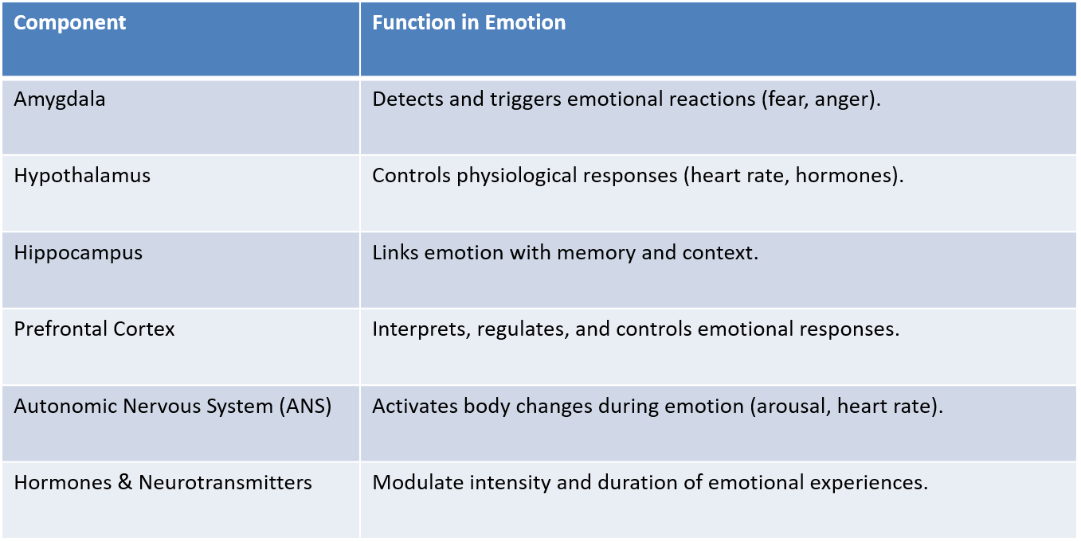
Brain and emotion
Amygdala: Processes fear and threat-related stimuli.
Hypothalamus: Regulates physiological responses.
Prefrontal Cortex: Modulates emotional control and decision-making.
Limbic System: Coordinates emotional responses

Slide 23
Brain and emotion
Amygdala: Processes fear and threat-related stimuli.
Hypothalamus: Regulates physiological responses.
Prefrontal Cortex: Modulates emotional control and decision-making.
Limbic System: Coordinates emotional responses

